Slide 1



Department of Electronics and Communication Engineering Final Review Design and Simulation of Bow-Tie Antenna for GPR Application (05/04/2024)
Team members:
Sangeeth V - 927621BEC174
Sarvesh M D - 927621BEC188
Sanjai B - 927621BEC176
Sanjai K - 927621BEC177
Guided by:
Dr.A.Kavitha.,
Prof, ECE.

Slide 2
OBJECTIVE
To design an Bow tie antenna with the frequency 1.25 Ghz. .
To Introduce a new AMC structure greatly improving the gain of proposed antenna.
Usage of wideband antenna for efficient GPR applications.

Slide 3
LITERATURE SURVEY
S.NO | Title of Project | Method | Merit | Demerit
1 | A 900MHz shielded bow-tie antenna system for ground penetrating radar | Development and application of a shielded bow-tie antenna system operating at 900MHz for ground-penetrating radar (GPR). | GPR is a valuable technology for subsurface imaging | The antenna system might be optimized for a specific application or environment
2 | Design of Low-Frequency Artificial Magnetic Conductor with Interleaved Gap and Lumped Elements | The design of a low-frequency artificial magnetic conductor (AMC) using interleaved gaps and lumped elements. | The focus on low-frequency design | The application of the artificial magnetic conductor may be limited to certain scenarios
3 | Research on high gain and high direction ground penetrating radar antenna loaded with hypermedia | Designing and investigating a ground-penetrating radar (GPR) antenna system with characteristics | This project emphasizes the development of an antenna system with high gain and high directionality. | The specific methods used in the research limits the ability to assess the project's validity.

Slide 4
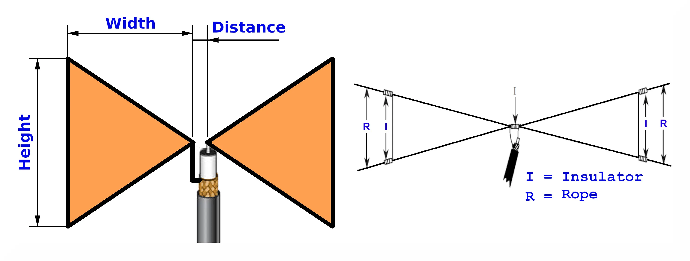
Bow-Tie Antenna
A bow-tie antenna is a wideband antenna with a planar shape and a two-dimensional biconical design. It's made up of two triangular stiff wire pieces or two triangular flat metal plates that stick out on both sides of the antenna, resembling a bow tie.

Slide 5
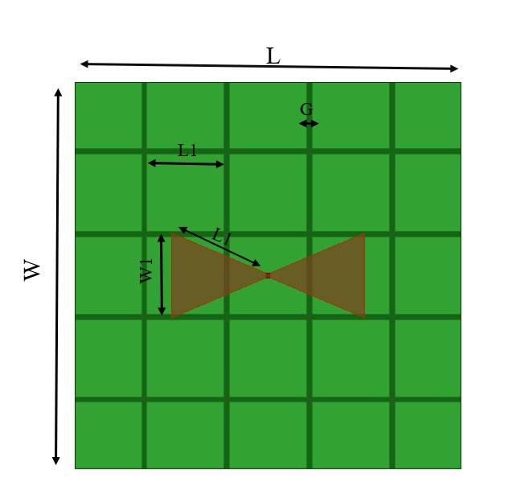
Design specification
Substrate material = FR4 epoxy
Dielectric Constant = 4.4
Operating Frequency = 1.25 GHz
Impedance = 50 ohms
Patch outer radius = 28.9 mm
Patch inner radius = 8.5 mm
Substrate thickness = 4 mm
Bow-Tie Antenna

Slide 6
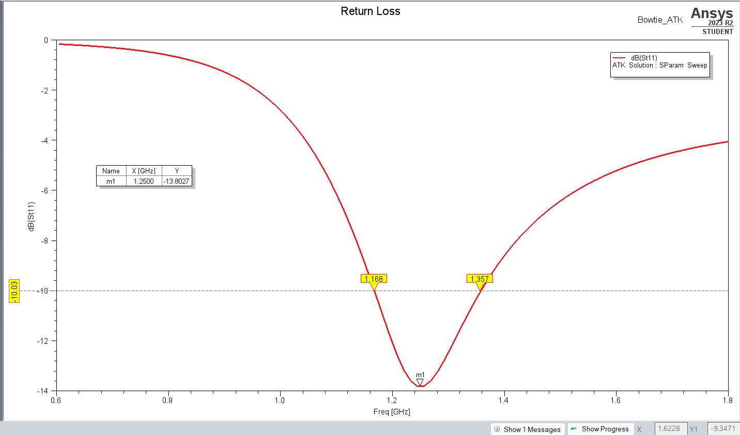
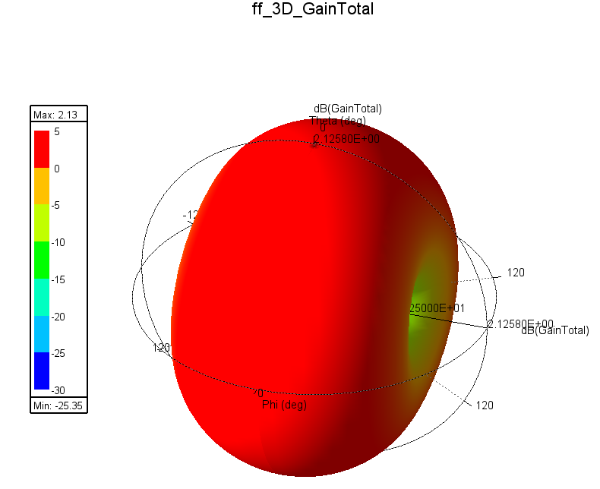
Results
Return Loss of the antenna
Gain of the antenna

Slide 7
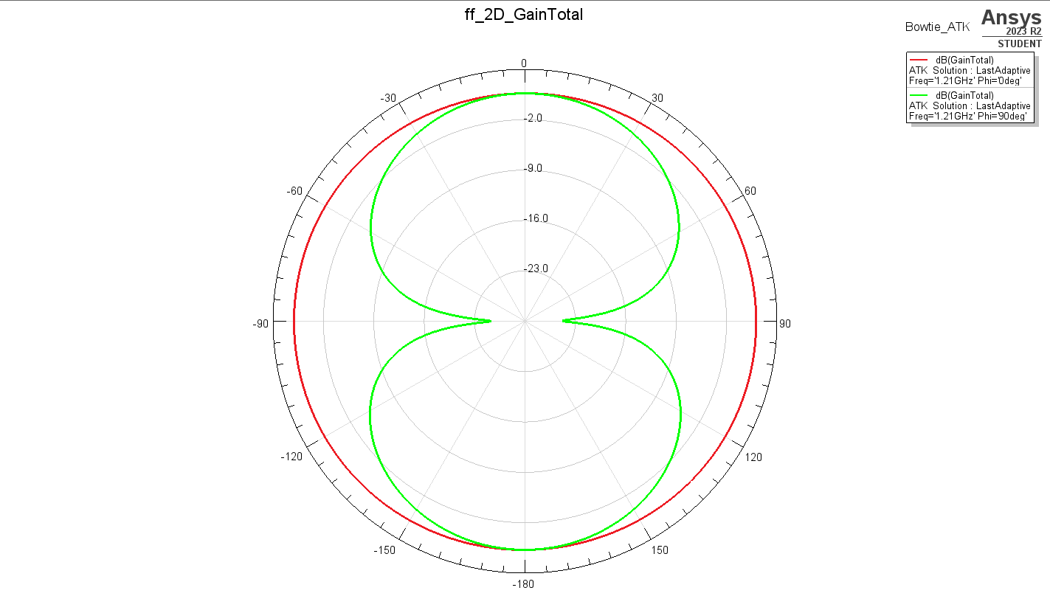
Radiation pattern of the antenna

Slide 8
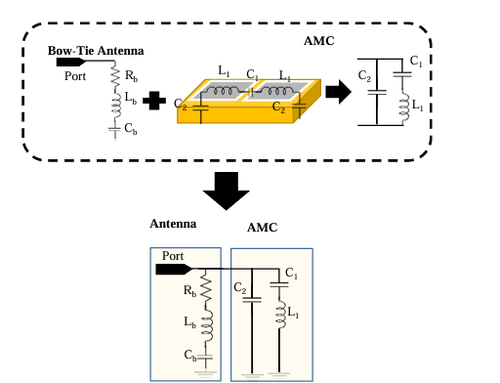
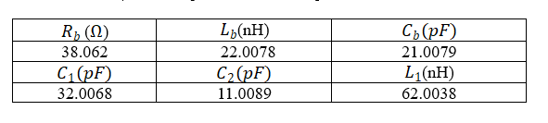
AMC Equivalent Circuit

Slide 9
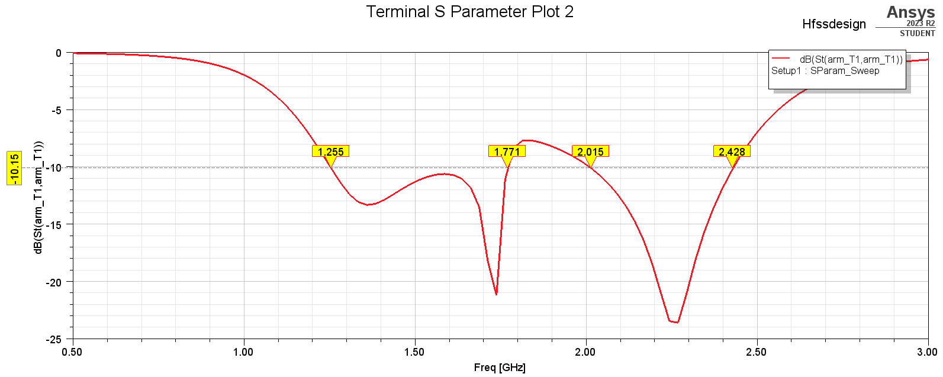
Results (with AMC)

Slide 10

OUTCOME
The project has been presented in the international conference at DHANISH AHMED INSTITUTE OF TECHNOLOGY

Slide 11
References:
[1] Wang Xiannan, "Basic research on key technologies of impulse GPR system," Jilin University, 2018.
[2] K. K. Ajith and A. Bhattacharya, "Improved ultra-wide bandwidth bow tie antenna with metamaterial lens for GPR applications," in Proceedings of the 15th International Conference on Ground Penetrating Radar, 2014, pp. 739-744.
[3] D Sievenpiper, L Zhang, R F J Broas et al., "High-Impedance Electromagnetic Surfaces with a Forbidden Frequency Band," IEEE Trans on MTT, vol. 47, no. 11, pp. 2059-2074, 1999.
[4] Feng Qiang, "Broadband antenna research based on artificial magnetic conductor," Harbin University of technology, 2016.
[5] G. Chen, L. Ce, Z Anxue, "Design and implementation of UWB back cavity butterfly antenna for ground penetrating radar," Journal of Radio Science, 2010,25 (02): 221-226.
[6] G. Chen and R. C. Liu, "A 900MHz shielded bow-tie antenna system for ground penetrating radar," Proceedings of the XIII Internarional Conference on Ground Penetrating Radar, Lecce, 2010, pp. 1-6.

Slide 12


